Slide 1
Scheduler Module

Slide 2
Version List
Versión índex | Date | Author | Description
1.0 | 15/11/2015 | Francisco Javier Quirarte Pelayo | First revisión of scheduler
 |  | David Antonio Díaz Ramírez

Slide 3
Functional Specification Scheduler Mechanism
Scheduling refers to making a sequence of time execution decisions at specific intervals, this decision that is made is based on a predictable algorithm. An application that does not need its current allocation leaves the resource available for another application's use.
The underlying algorithm defines how the term “controlled” is interpreted, in some instances, the scheduling algorithm might guarantee that all applications have some access to the resource. The Binary Progression Scheduler (BPS) manages the access to the CPU resources in a controlled way.

Slide 4
Tasks Partitioning
Task Partitioning is used to bind a task to a subset of the system's available resources, this binding guarantees that a known amount of resources is always available to the task. Those resources are taken by time-slicing the available processing time, systems that use time-slicing take advantage of the CPU/Core utilization and keeping the CPU/Core occupied which enhance the use of the MCU resources. A processor always have a task to execute even though all the other tasks are idle, when no tasks are executed the processor is running a Background Task

Slide 5
Mask Concept
The Scheduler is based on a binary counter incremented at a given time, this time is controlled by a timer interrupt, typically called OS Tick.
A mask is a number defined by: mask = (2^n)-1
Where n represents the counter data size (8bits, 16bits …) which depends on the number of tasks to be provided by the scheduler module, n should be choosen at desing stage by the scheduler designer.
The mask is used to mark a task for execution, when the binary counter and the mask: (mask & counter) == mask From the previous definition, the task is assigned to a range of time-slices.
Given the mask and the OS tick period we can obtain the task rate. Therefore the task rate is: task rate = OS tick * (mask + 1).

Slide 6
Offset Concept
A collision may occur between the tasks when the tasks share the same time-slice. If a collision is present some tasks will start being executed in a not desirable time. An offset is defined to allow the task execution being moved in different time-slices. The offset can only be defined in the range from the count of zero up to the value defined by the mask. When the counter matches the mask, and the matched value is the same as the given offset the task is ready to be executed. (mask & counter) == offset With this approach the task collision is avoided.

Slide 7
Dependencies to other modules
The scheduler module has dependencies on project specific timer module.
The include structure of the Scheduler module shall be as follows:

Slide 8
File Name | Description
Tasks.c | Provides the timed task definitions
Tasks.h | Export the timed task interfaces to the scheduler configuration file
Exceptions.c | Setup of IVPR to point to the EXCEPTION HANDLERS memory area defined in the linker command file.
Exceptions.h | Export the Exception handlers to scheduler module
Timer.c | Configurate the STM timer initialization and configurate the STM flag in 1 ms
Timer.h | Export the STM flag and rise the tickflag each 1 millisecond
Leds.c | Configured the PORT A as outputs and led1 to led4 on board
Leds.h | Export the configuration of porta and led1 to led4 on board
Typedesfs.h | This file defines all of the data types for the Motorola header file
Stdtypedef.h | Public type header file for the coreHAL
INIT.c | Initialise PLL before turning it on
INIT.h | Export the pll configuration
IntcInterrupts.c | Contains an implementations of generic interrupt controller handling routines for the MPC56xx and PX MCU families
IntcInterrupts.h | Export the interface of interrupt controller handing
Kernel.h | Contain all headers implemented in the system

Slide 9
API Specification
Name: | Taskmasktype
type | U32
Range: | tickflag | Mask_1ms | OxFA00 | Mask required for 1 ms task
 | task1 | Mask_1ms |  | Mask required for 1 ms task
 | task2 | Mask_3ms |  | Mask required for 3 ms task
 | Task3 | Mask_5ms |  | Mask required for 5 ms task
 | task4 | Mask_17ms |  | Mask required for 17 ms task
Description | The mask values to generate the task periods

Slide 10
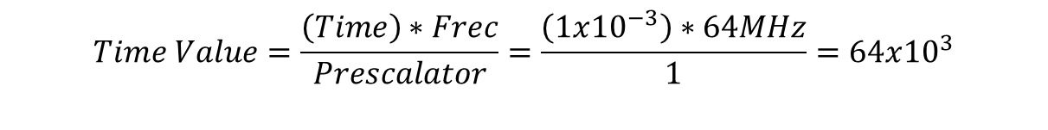
STM time formula
$$Time Value=\frac{\left(Time\right)∗Frec}{Prescalator}=\frac{\left(1x{10}^{−3}\right)∗64MHz}{1}=64x{10}^{3}$$
$\text{DECIMAL}=64x{10}^{3} −−→$HEX = 0x0000FA00

Slide 11
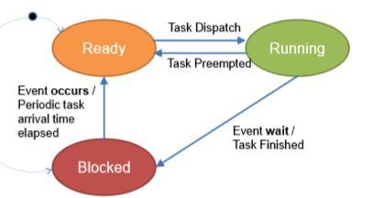
Name: | taskStateType
Type: | U8
Range: | Task_state_suspended | Task state initial value
 | Task_state_ready | Task state indicates the task is ready to be executed
 | Task_state_running | Task state indicates the task iscurrectly running
Description: | Task states

Slide 12
Schmodule_configType
Name: | scheduler
Type: | u8
Range: | n.a. | Structure to hold the module 's configuration set. The Contents of this data structure are implementation specific
Description: | Counter tasks trought the tickflag
Name: | S_TASKS
Type: | structure
Range: | Implementation specific structure | Structure to hold the module’s configuration set. The contents of this data structure are implementation specific.
Description: | Configuration of members: period, offset and function of the tasks

Slide 13
Name: | TASK_LIST
Type: | array
Range: | Implementation specific array | array to hold the module’s configuration set. The contents of this data structure are implementation specific.
Description: | Configuration of members: period, offset and function of the tasks

Slide 14
Public Function Definitions Public functions shall be exported in SchModule.h file and defined in SchModule.c file.
Name: | INTC_InstallINTCInterruptHandler
syntax | Void INTC_InstallINTCInterruptHandler(function, port,1)
Parameters(in/out) | Function type | handlerFn
Parameter2(in/out) | Port(N) | unsigned short vectorNum Configuration of required port of the board
Parameter3(in/out) |  | unsigned char psrPriority
Description: | Configuration of interrupts handler
DESCRIPTION: Contains an implementations of generic interrupt
controller handling routines for the MPC56xx and PX MCU families.

Slide 15
Name: | INTC_INTCInterruptHandler
syntax | Void INTC_INTCInterruptHandler (function, port,1)
Parameters(in/out) | n.a. | handlerFn
Description: | e200z0h IVOR branch table interrupts for core 0.

Slide 16
Private Function Definitions Private functions shall be defined in SchModule.c file.
Service name: | Tickflag
Syntax: | Void tickflag( Void )
Parameters(in/out) | None
Parameters(in/out) | None
Returns value: | None
Description: | Callback function periodically called from the timer module providing the tick reference

Slide 17
Service name: | STM_config_clock
Syntax: | Void STM_config_clock (Void)
Parameters(in/out) | None
Parameters(in/out) | None
Returns value: | None
Description: | Configure the STM flag at 1ms and initialize the counter
Service name: | function_time
Syntax: | Void function_time (Void)
Parameters(in/out) | None
Parameters(in/out) | None
Returns value: | None
Description: | resets the flag on channel 0 and rise the flag each 1 millisecond

Slide 18
Name: | Tareas
Type: | enum
Range: | Implementation specific enum | enum to hold the module’s configuration set. The contents of this data structure are implementation specific.
Location: | Tasks.h
Description: | add the number of tasks

Slide 19
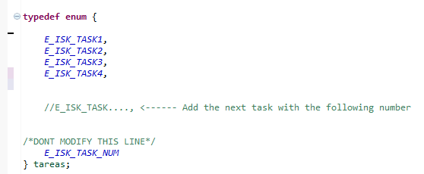
Adding more functions to the scheduler
In order to add another task in the scheduler system, please follow the next steps:
In the file tasks.h, in the enum structure, write with the same format, the name of the next function. Is important not to modify E_ISK_TASK_NUM. Please refer to the next image:

Slide 20
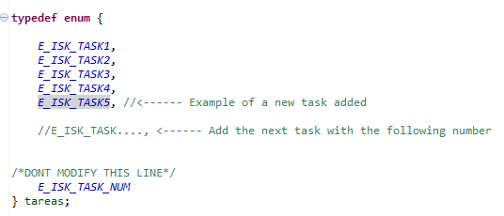
Example of a new task added:

Slide 21
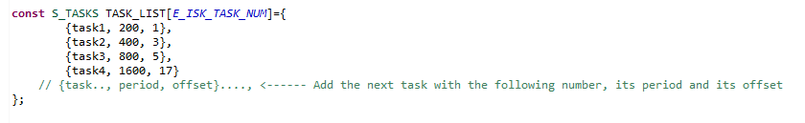
2) In the file main.c, in the Inline functions section, in the S_TASK type structure TASK_LIST, write with the same format, the name of the next task, its period and its offset. Please refer to the next image:

Slide 22
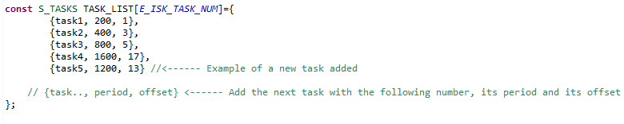
Example of a new task added:

Slide 23
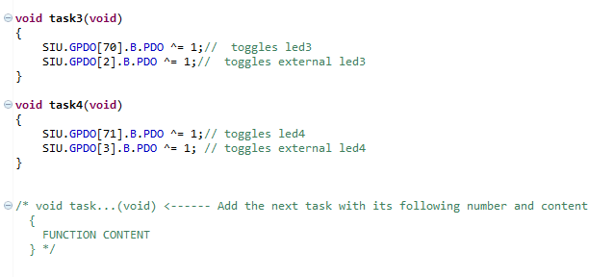
3) In the task.c file, add the next function for the task with its following number and content.

Slide 24
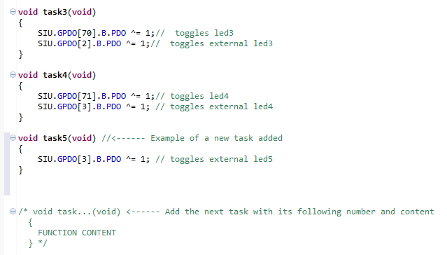
Example of a new task added:

